Slide 1
13th General Assembly
September 21st, 2026, Tirana, Albania
Proposed UEAA Priorities and Activities for 2026-2028
Prof. Dr. NAZIM GRUDA Prof. Dr. Simone Orlandini
ASA - Albania Accademia dei Georgofili, Italy

Slide 2

VISION & MISSION
VISION
MISSION
A strong European scientific community advancing sustainable and resilient agriculture, food systems, and natural resource management.
To advance applied science in agriculture, food, and nature across Europe through collaboration, innovation, and knowledge exchange, addressing major European challenges and connecting science, policy, and practice.

Slide 3
➜
FROM CONTINUITY TO ACTION
The 2026–2028 programme builds on the 2024–2026 UEAA programme and aligns with European and global sustainability goals.
Scientific platform
Science–policy bridge
Evidence-based decisions
Connect academies and experts across Europe.
Translate scientific evidence into policy and practice.
Support resilient, sustainable, and competitive systems.
Aligned with EU strategic objectives and the UN 2030 Agenda for Sustainable Development
UEAA • Proposed Priorities and Activities 2026–2028

Slide 4
◎
OUR ROLE FOR A SUSTAINABLE AGRICULTURAL STRATEGY
Objective
Promote sustainable agricultural practices that enhance productivity, resilience and environmental health.
Policy advocacy
Research & collaboration
Support for farmers
Advance science-based policies for sustainability, competitiveness, food security and innovation.
Link academia, policymakers, and the agricultural sector around sustainable agriculture.
Improve access to knowledge, resources and funding while strengthening resilience and fair returns.
UEAA • Proposed Priorities and Activities 2026–2028

Slide 5
✦
CROSS-CUTTING THEMES
Climate change
Food security
Adaptation and mitigation
Nutrition and resilient food systems
Biodiversity
Capacity building
Ecosystem services and natural resources
Education, training and knowledge exchange
UEAA • Proposed Priorities and Activities 2026–2028

Slide 6
➤
UEAA PRIORITIES AND ACTIONS
Four priorities for 2026–2028
1 Strengthen political influence in the EU
2 Support European academies
3 Expand UEAA membership
4 Engage young scientists
UEAA • Proposed Priorities and Activities 2026–2028

Slide 7




PRIORITY 1
STRENGTHENING POLITICAL INFLUENCE IN THE EU
Objective
Increase UEAA’s political weight and ensure that applied science contributes to EU policy.
EU engagement
Innovation dialogue
Strategic priorities
Build stronger relationships with key European institutions and contribute to the Common Agricultural Policy
(CAP) discussions.
Promote research innovations, including genome editing and other novel technologies, in dialogue with the European Commission.
Contribute expertise in sustainable water management, climate adaptation, and EU strategies for agriculture, food, nature, and forests.
UEAA • Proposed Priorities and Activities 2026–2028

Slide 8


PRIORITY 2
SUPPORTING EUROPEAN ACADEMIES
Objective
Support member academies and advocate for their role in scientific research.
Research collaboration
Knowledge exchange
Visibility
Strengthen existing UEAA electronic Working Groups; create a new eWG to address emerging challenges.
Facilitate collaboration and exchange among the agricultural academies.
Promote the scientific activities and contributions of UEAA member academies (Newsletters).
Start reorganizing the SC. Each SC member should take responsibility for a task.
UEAA • Proposed Priorities and Activities 2026–2028

Slide 9
PRIORITY 3
EXPAND UEAA MEMBERSHIP
Objective
Strengthen UEAA’s European presence and network through broader membership and engagement.
Broaden participation
Strengthen collaboration
Grow membership
More meetings with member academies; use proven instruments such as abstract award competitions.
Connect UEAA activities with member academies’ strategic priorities and promote knowledge exchange (e.g., LAS Int. Advisory Council).
Target new academies and strengthen collaboration across Europe, e.g., the Andalusian Academy of Agriculture.
Engage the full UEAA network — and expand it.
UEAA • Proposed Priorities and Activities 2026–2028

Slide 10

PRIORITY 4
ENGAGING YOUNG SCIENTISTS
Objective
Strengthen participation and collaboration of early-career researchers across Europe.
European platform
International collaboration
Visibility & participation
Support the European Platform of Young Scientists (two words from representatives).
Engage young researchers in interdisciplinary and cross-border cooperation (New EU Proposals).
Increase the role of young scientists in European research and policy discussions (Ex officio SC Advisory Membership).
UEAA • Proposed Priorities and Activities 2026–2028

Slide 11
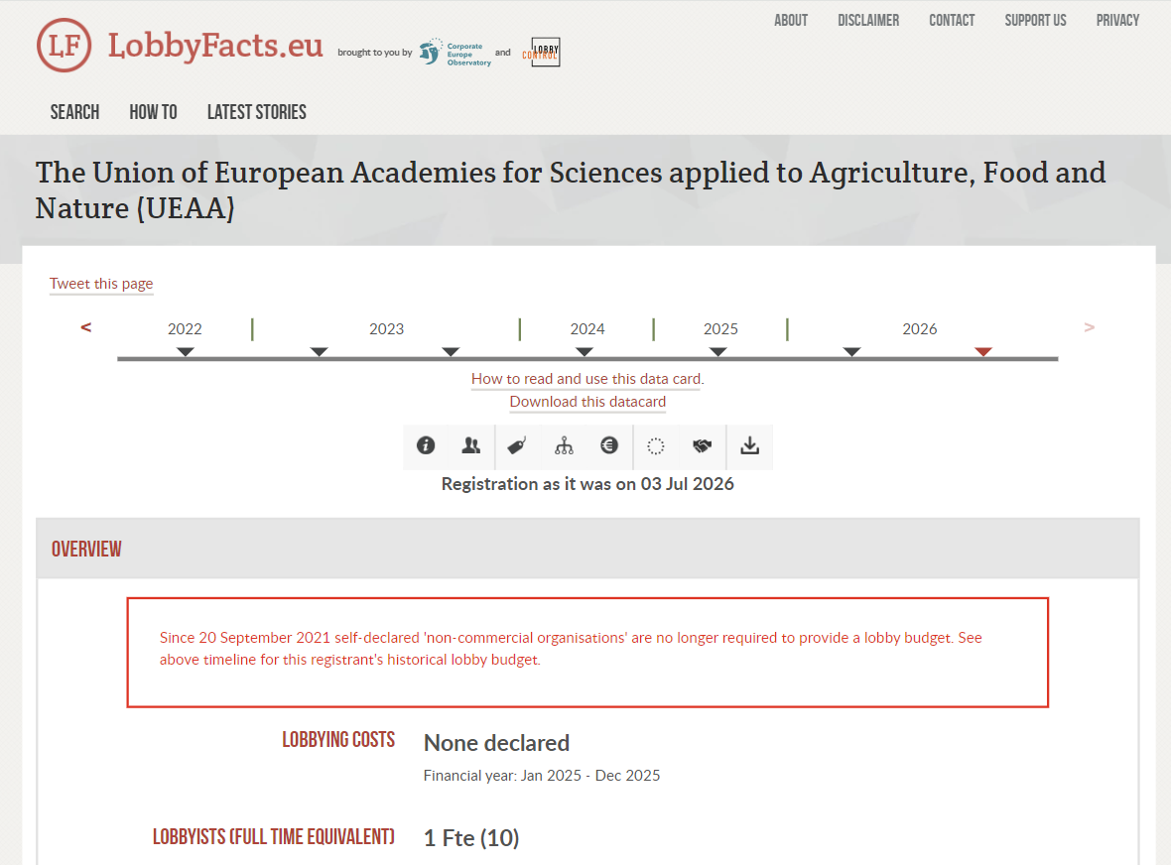
Strategic Goal
Objective
Change the Status of the Union

Slide 12
Strategic Goal: From a Network of Academies to a Coordinated European Scientific Force
Objective
Change the Status of the Union
Develop a more professional and permanent organizational structure
Move from an occasion-driven network toward a coordinated scientific task force
Mobilize the combined expertise of UEAA member academies around strategic European priorities
Strengthen UEAA’s visibility, responsiveness, and credibility at the European level
Position UEAA as a recognized scientific partner for European institutions

Slide 13
How Do We Get There? — Implementation
Establish a Strategic Working Group
Mandate: Translate the strategic goal into an actionable roadmap for 2026–2028/2029 (4-5 years)
Chair: Simone Orlandini
UEAA Vice President
CORE TASKS
Operating Model
Digital Infrastructure
Define responsibilities, decision-making, coordination, and member academy roles
Redesign and relaunch of the UEAA website.
Scientific Engagement
Financial Sustainability
Flexible Electronic Working Groups to address priority European issues
Explore member contributions, external partnerships, sponsorship, and EU funding opportunities
TIMELINE • Next Steering Committee meeting: Establish the Strategic Working Group

Slide 14
WHAT ARE WE ASKING THE GENERAL ASSEMBLY TO DECIDE?
PROPOSED DECISION
The General Assembly Agrees to Initiate a Structured Process to Develop a Future UEAA Strategy.
1
Continue the
strategic discussion
2
Establish the Strategic Working Group
and develop a roadmap
3
Submit concrete proposals for
formal consideration where required
TODAY: MANDATE THE PROCESS — NOT THE FINAL STRATEGY

Slide 15
THANK YOU FOR YOUR ATTENTION
UEAA • 13th General Assembly • Tirana, 21 September 2026

